Slide 1
FOREX
INFO7374 - Machine Learning in Finance - Project Final Presentation
Team Members:
Vignesh Thiagarajan
Simi Foss
Jocelyn Quadras
Sanket Kumar
Ajay Vishwanathan
Shreyansh Singh

Slide 2
What is 'FOREX'
Forex stands for Foreign Exchange market
The Forex market is decentralized.
The Forex market is the largest financial market in the world [ daily average turnover of US$3.2 trillion]
The Forex market is open 24 hours a day, 5 days a week
Currencies are always traded in pair
You can buy and you can sell currency pairs
Notes:
decentralized - This means that there is no one single Forex market, like in stock trading and local stock exchanges, for example.

Slide 3
'FOREX Market'
Average daily turnover in global foreign exchange markets is estimated at $3.21 trillion.
The Break Up of this $3.21 is as follows:-
$1.005 trillion in spot transactions
$362 billion in outright forwards
$1.714 trillion in foreign exchange swaps
$129 billion estimated gaps in reporting
85% of all daily transactions involve trading a group of
currencies known as the "Majors."

Slide 4
Some Reasons to Trade in FOREX
24-hour forex trading
Superior liquidity
100:1 Leverage in forex trading
Lower transaction costs
Equal profit potential in both rising and falling markets

Slide 5
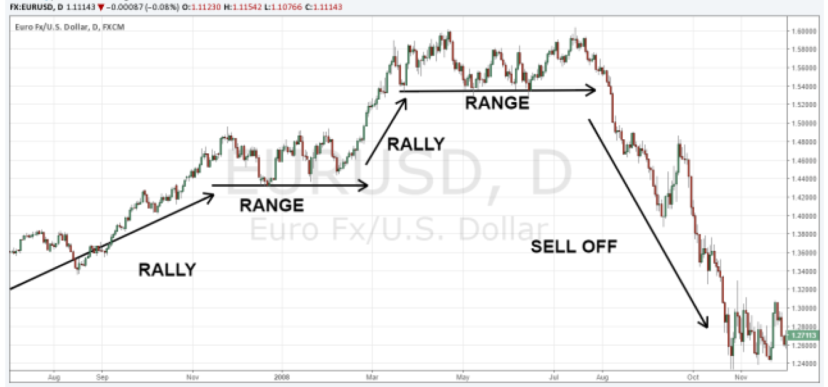
Price direction
Markets can do one of three things:
it can go up (rally – bullish trend),
it can go down (sell off- bearish trend)
and it can go sideways (range market)

Slide 6
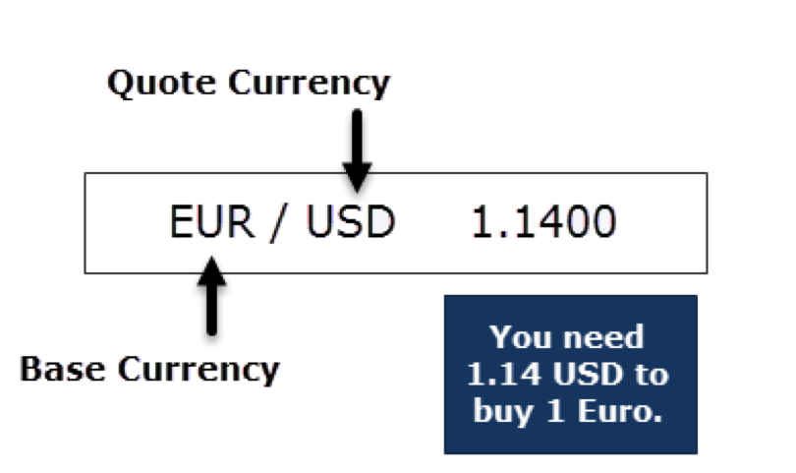
Forex Pairs
The first currency in a currency pair is the base currency and the second one the quote currency.

Slide 7
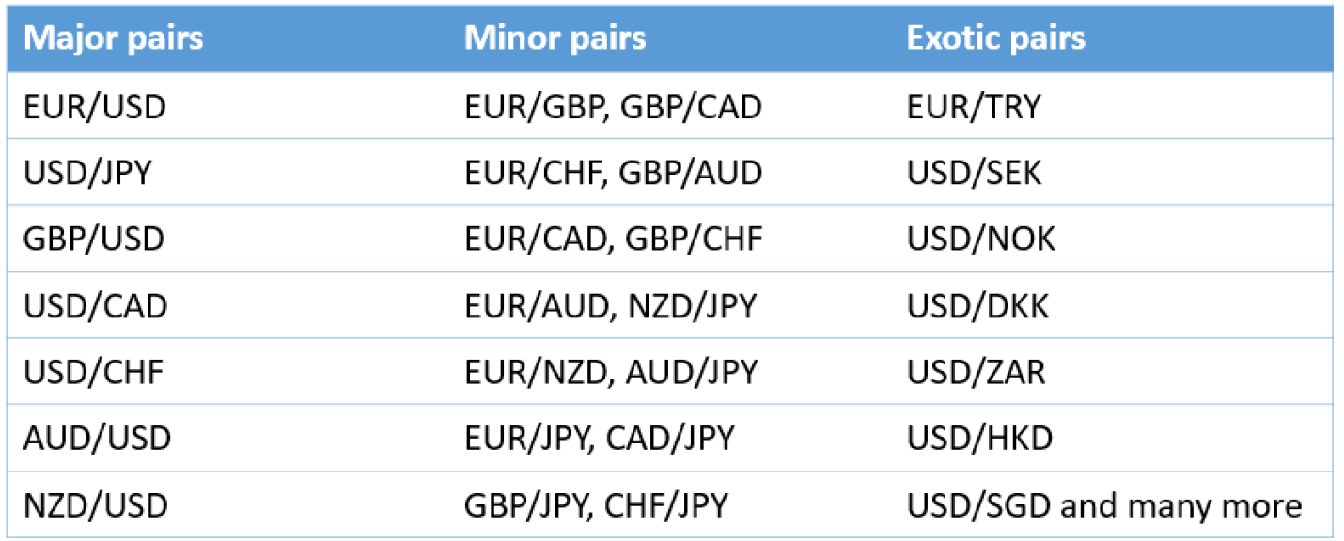
Forex Pairs
Every Forex pair has 2 prices:
Ask price: price sellers are willing to sell – price when you enter buy trade
Bid price: price buyers are willing to pay – price when you enter sell trade
The difference between bid and ask price is called spread -> cost of trading.
There are 3 different classes when it comes to Forex pairs: Majors (the most commonly traded), Minors and Exotic Forex pairs.

Slide 8
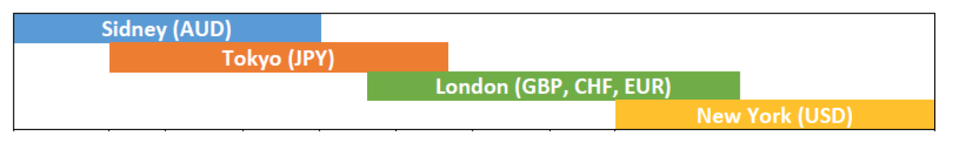
Trading session
Individual currencies are most active during their own “trading session”
When the trading sessions overlap -> highest trading activity
Trading week for a Forex trader -> Monday morning when Sidney opens and ends on Friday when New York closes.

Slide 9
Currency Pair – EUR/USD
The EUR/USD is affected by factors that influence the value of the euro and/or the U.S. dollar in relation to each other
The Interest rate differential between the European Central Bank (ECB) and the Federal Reserve (Fed) affects the value of these currencies when compared to each other.
For example, when the Fed intervenes in open market activities to make the U.S. dollar stronger, the value of the EUR/USD cross could decline due to a strengthening of the U.S. dollar compared to the euro.

Slide 10
Currency Pair – USD/JPY
Yen remains a safe haven currency, meaning in times of investor stress or market turmoil, the Japanese yen appreciates. This was evident during the Great Recession
Yen tends to weaken when the global economy is strong.
Interest rate differential between the Federal Reserve (Fed) and the Bank of Japan (BoJ)
USD/JPY is correlated with gold.

Slide 11
Currency Pair – USD/CNY
The most popular China Yuan Renminbi exchange pair is the USD:CNY.
During the period from 1997 to 2005, the China used conventional dollar peg system, and the Chinese yuan was valued at approximately 8.3 CNY per U.S. dollar.
In 2005, the Chinese government transitioned to a managed floating rate system and revalued the CNY to 8.1 per USD.
The People's Bank of China (PBOC) devalued the yuan by nearly 2 percent on Aug. 11, 2015., weaker against the US dollar
The PBOC called it a free-market reform.

Slide 12
Currency Pair – USD/CNY(cont.)
The low yuan encourages over-investment in China’s export manufacturing sector at the expense of the domestic market
The undervalued currency makes imports into China more expensive and out of reach for the ordinary citizen.

Slide 13
Currency Pair – AUD/USD
Interest Rate Differential between the Reserve Bank of Australia (RBA) and the Federal Reserve (Fed)
Australia is the largest gold, coal and iron ore exporter, and therefore the plight of its currency is heavily dependent on them.
The Australian dollar also tends to track equities, so when these markets began to capitulate back in 2008 so too did the AUD.
During the commodity slump of 2015 that saw oil prices hit decade lows and both iron ore and coal prices slumped, the Australian dollar weakened sharply.

Slide 14
Currency Pair – USD/CAD
Interest rate differential between the Federal Reserve (Fed) and the Bank of Canada (BoC)
The value of the Canadian dollar is highly correlated with the price of commodities, especially oil.
The price of oil dictates the health of the economy.
In 2016, when oil prices slumped to decade-lows, trading below $30 a barrel, the Canadian dollar hit a record low, trading to 1.46, meaning it required 1.46 Canadian dollars to buy 1 U.S. dollar.
Although the correlation is never static, over the last ten to fifteen years, the Canadian dollar has held a positive correlation to oil of more than 75% on average.

Slide 15
Currency Pair – GBP/USD
Interest rate differential between the Bank of England (BoE) and the Federal Reserve (Fed)
During the Great Recession, the value of the British pound fell sharply. In 2007, the GBP/USD traded to an all-time high above 2.10, before falling below 1.40, losing over a third of its value
The GBP/USD had another sharp decline in June 2016, when Britain voted to leave the European Union
The GBP/USD pair fell 10 percent in one trading session and lost nearly 20 percent in the month proceeding the Brexit vote.

Slide 16
Strategies, Models and Indicators
Relative Strength Index(RSI)
Moving Average Trading Strategy
Bollinger Bands
Principal Component Analysis(PCA)
Kalman Filters

Slide 17
RSI indicator (Relative Strength Index)
Trend indicator which is used to analyze trending markets and waves
It is primarily used to identify overbought and oversold condition in the trading of an asset
RSI is widely used as an oscillator that indicates a market is overbought when the RSI value is over 70 and indicates oversold conditions when RSI readings are under 30
RSI = 100 - [100 / (1 + RS)]
where RS (Relative Strength) = average gain / average loss

Slide 18
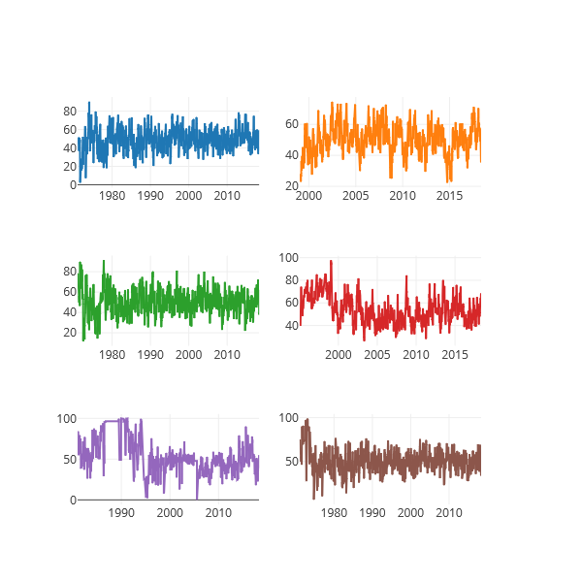

Slide 19
Moving Average Trading Strategy
The moving average crossover is when the price of an asset moves from one side of a moving average to the other
A change in momentum and indicates that strong move is likely approaching
Buy Signal : When Short Moving Average crosses Long Moving Average
Sell Signal : When Long Moving Average crosses Short Moving Average
MA simplifies the price chart and cuts down the amount of noise
MA with short term will react much quicker to price change than MA with long term period

Slide 20
Moving Average Trading Strategy
Steps:
Loopback periods: short window = 150 days and long window = 300 days
Compute short and long moving averages over respective short and long time windows
Generate signals when short moving average crosses the long moving average for a period greater than the shortest moving average window
Actual trading orders is generated by taking the difference of the signals to distinguish between long and short positions (-1 Sell, Buy -1)

Slide 21
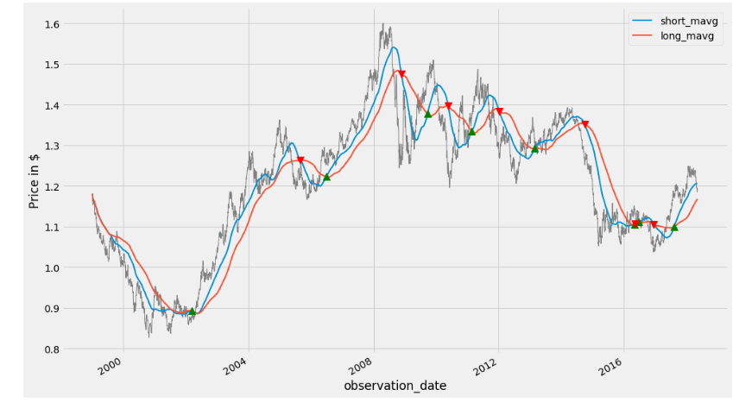
Trading signals for US to EU currency pair

Slide 22
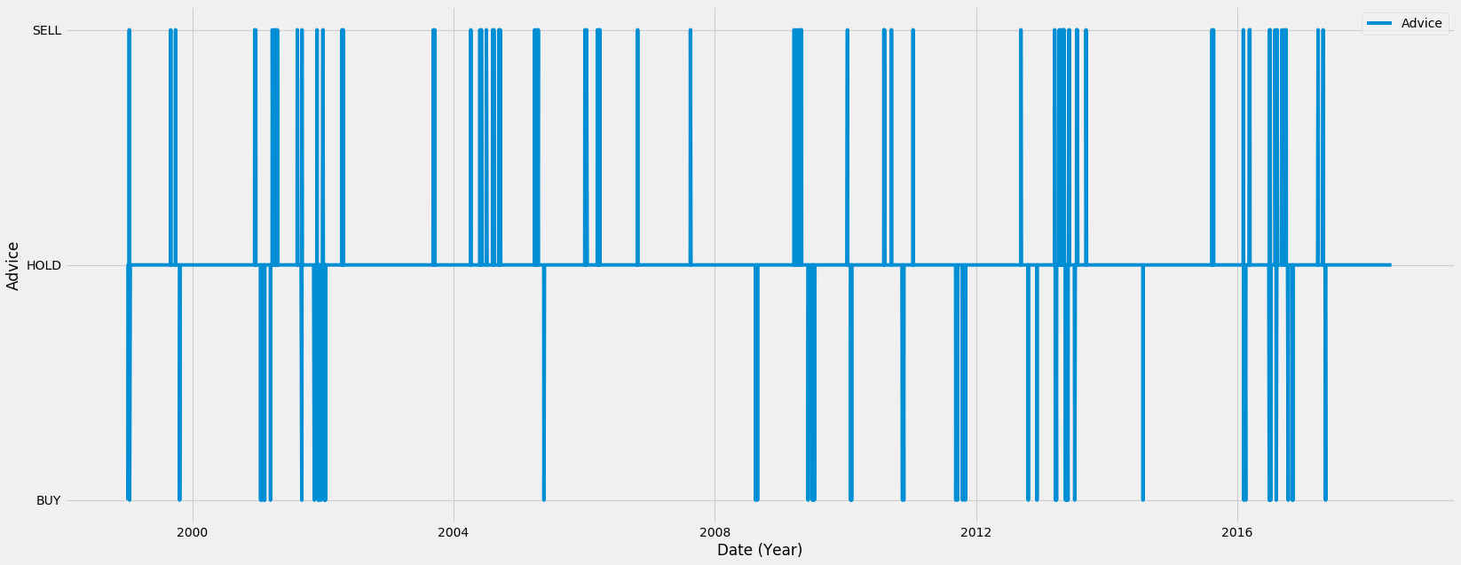
Advice signals for US to EU currency pair

Slide 23
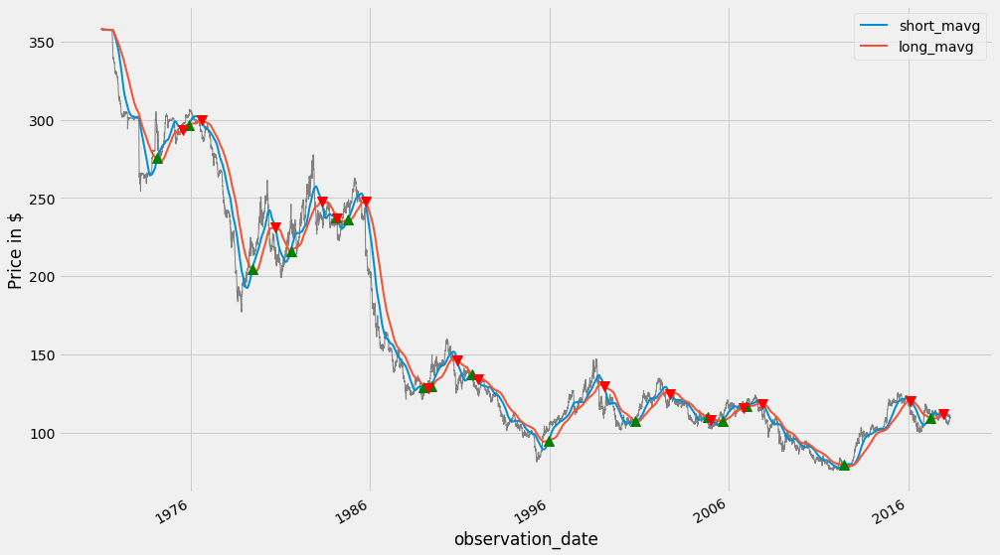
Trading signals for US to JP currency pair

Slide 24
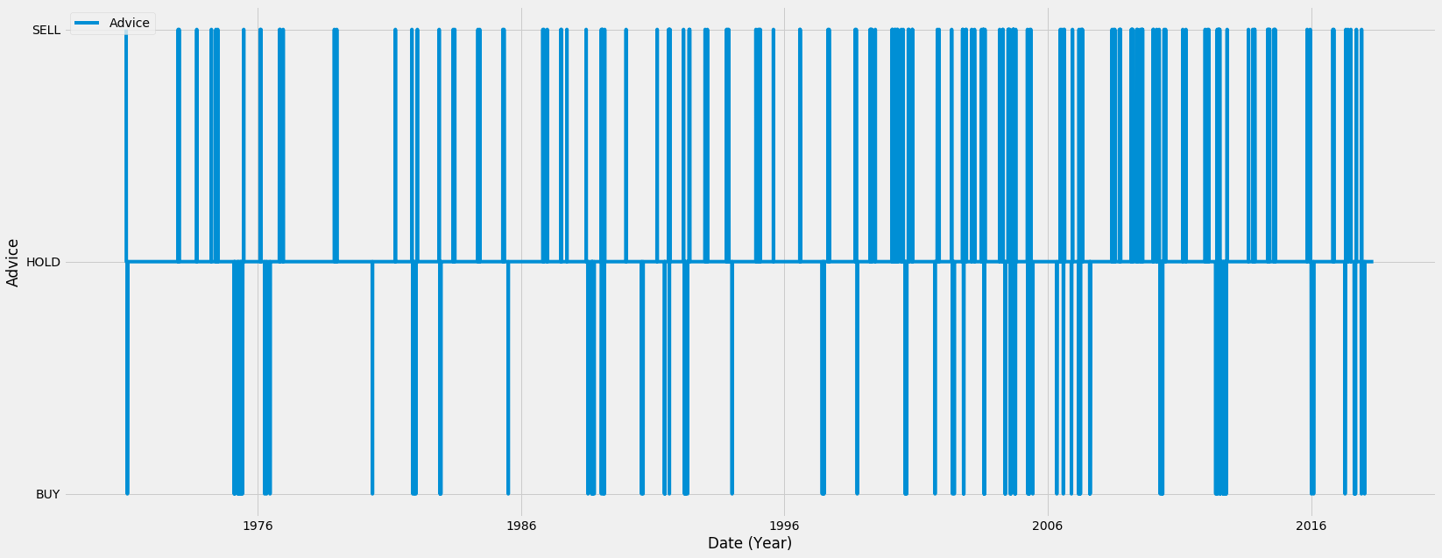
Advice signals for US to JP currency pair

Slide 25
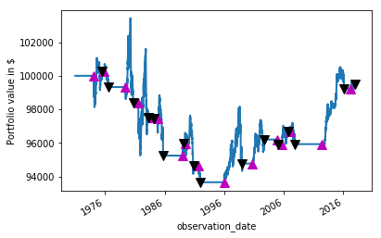
Backtesting

Slide 26
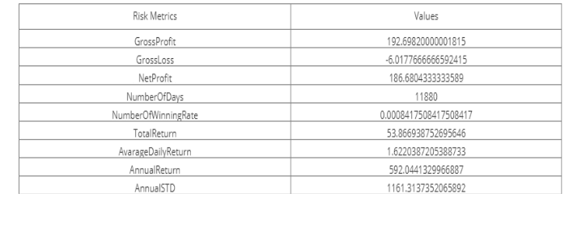
Risk Analysis

Slide 27
Common Financial Analysis
Daily percentage change
Cumulative daily returns
Volatility

Slide 28
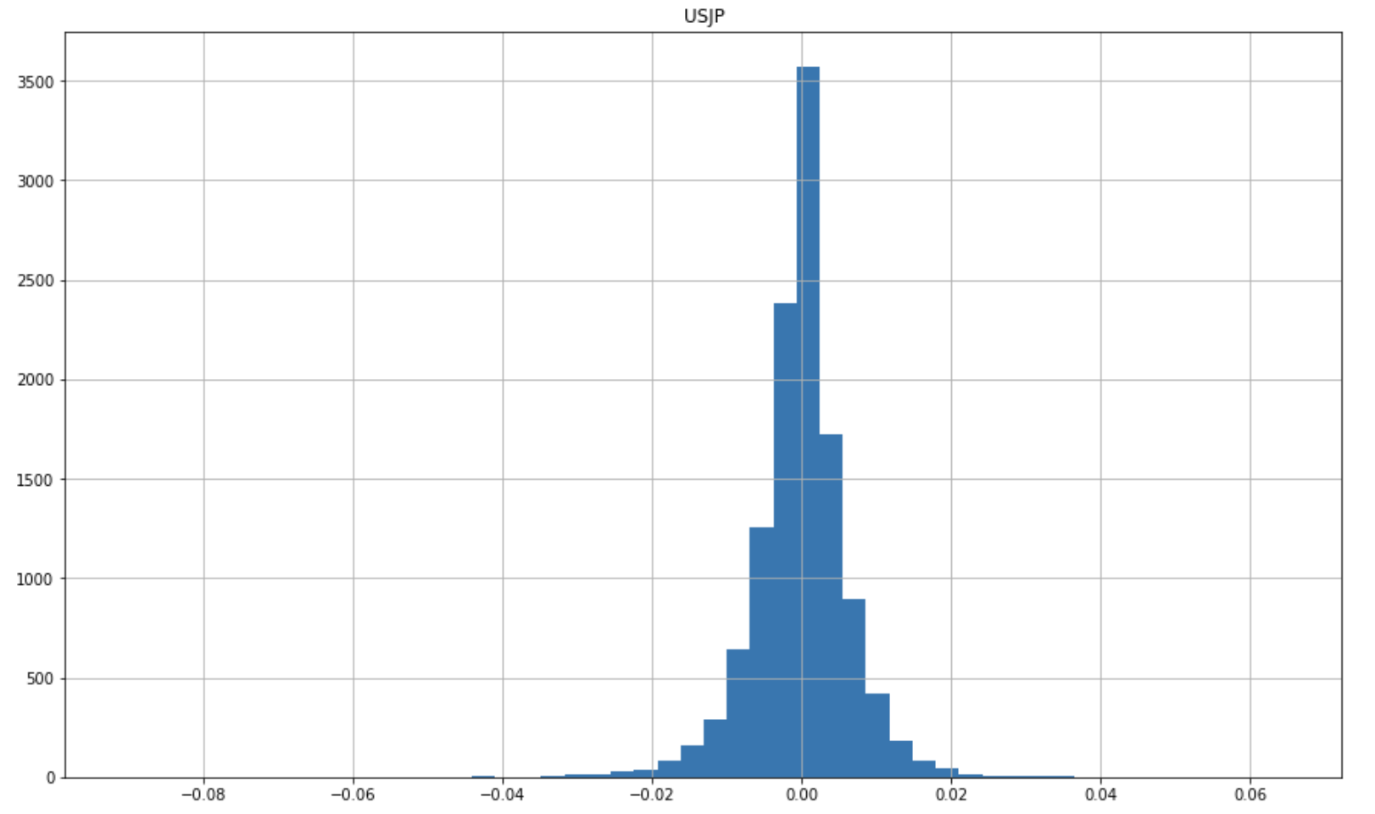
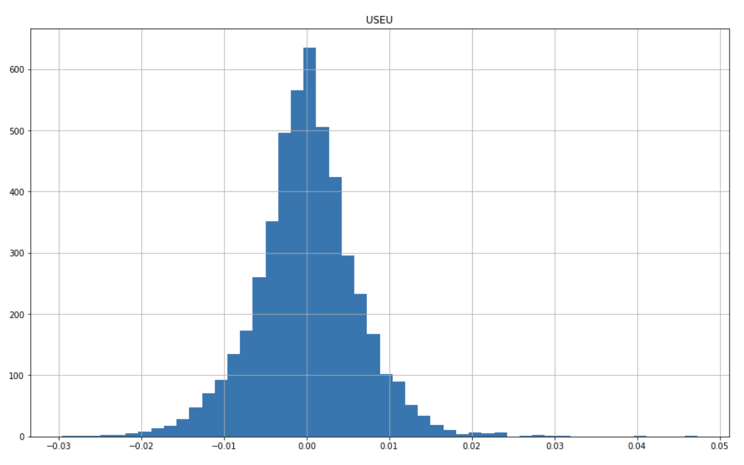
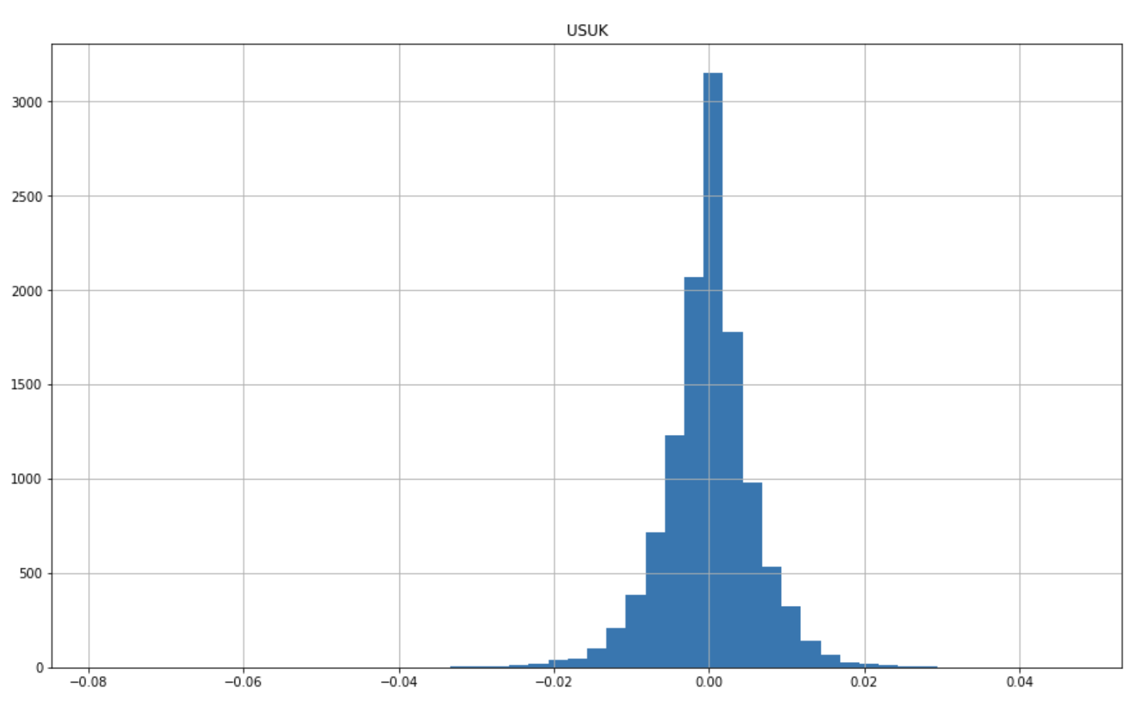
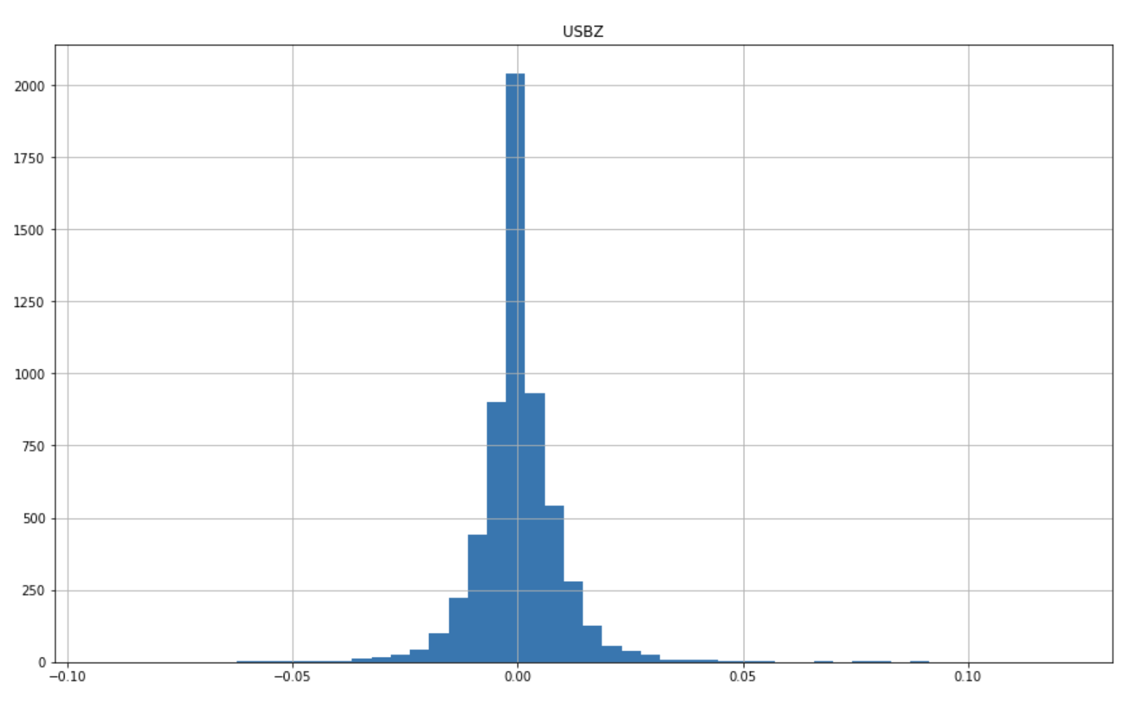
Daily Percentage Change

Slide 29
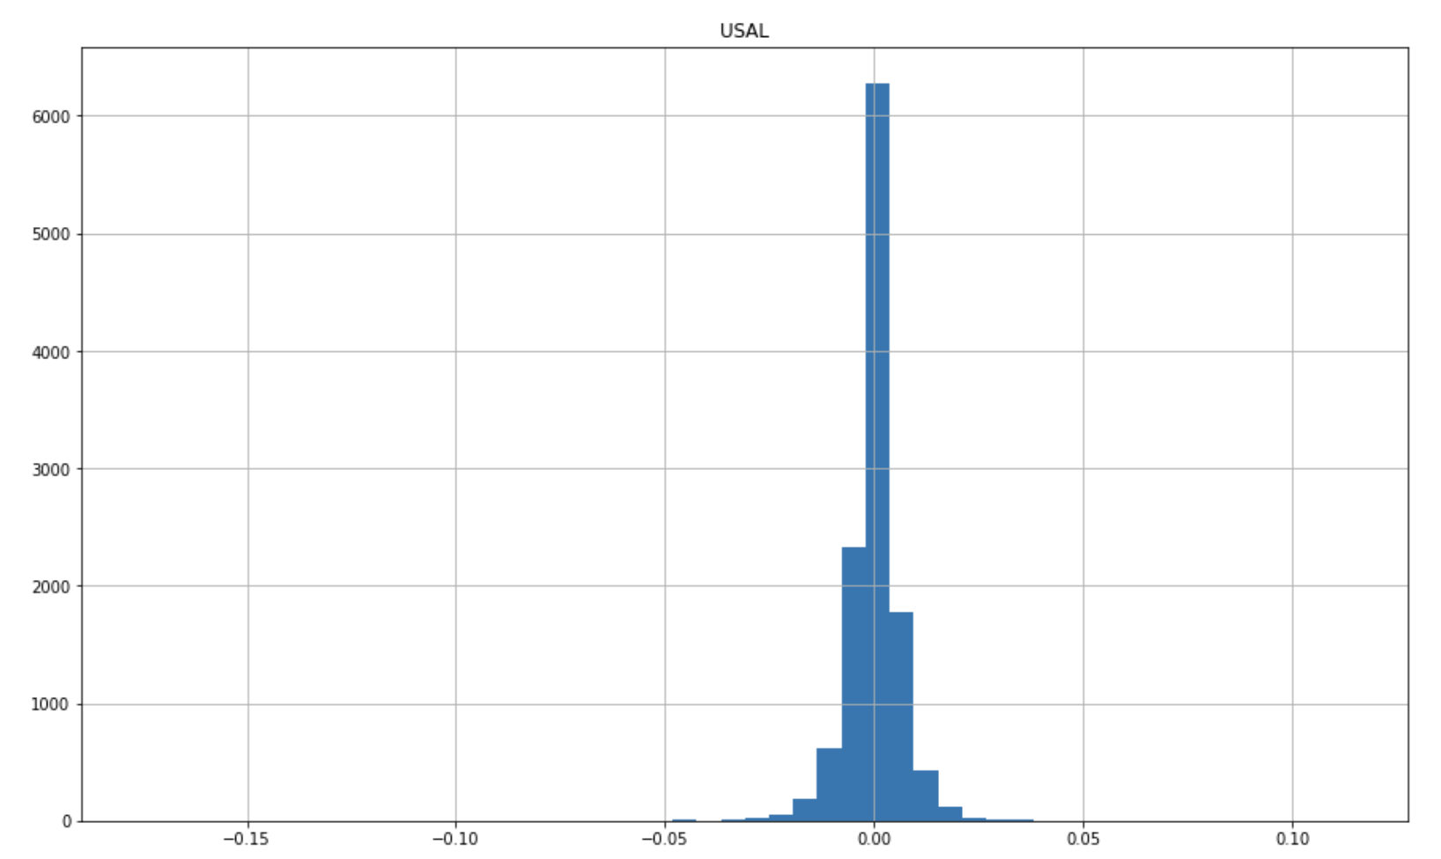
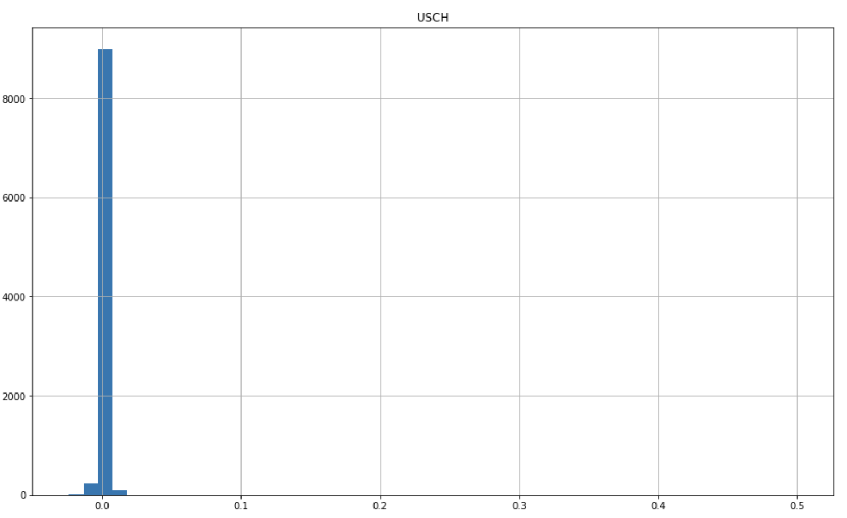
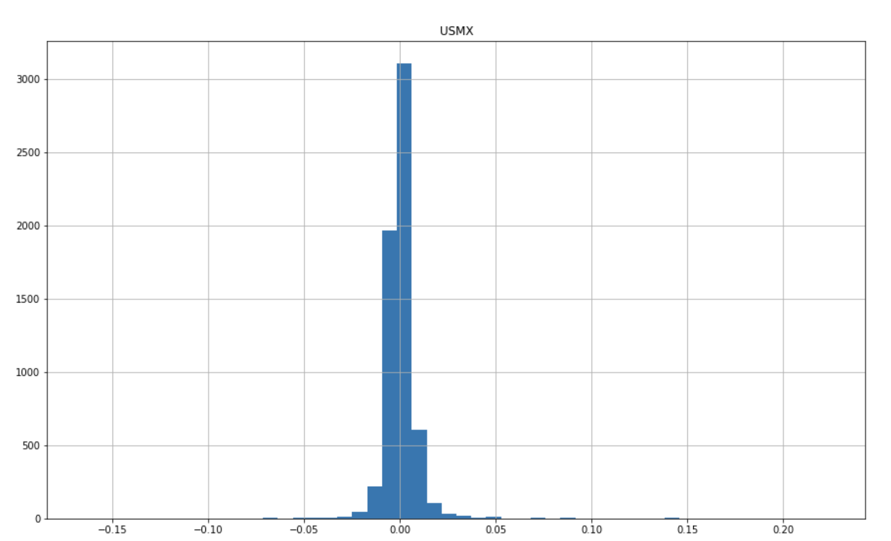

Slide 30
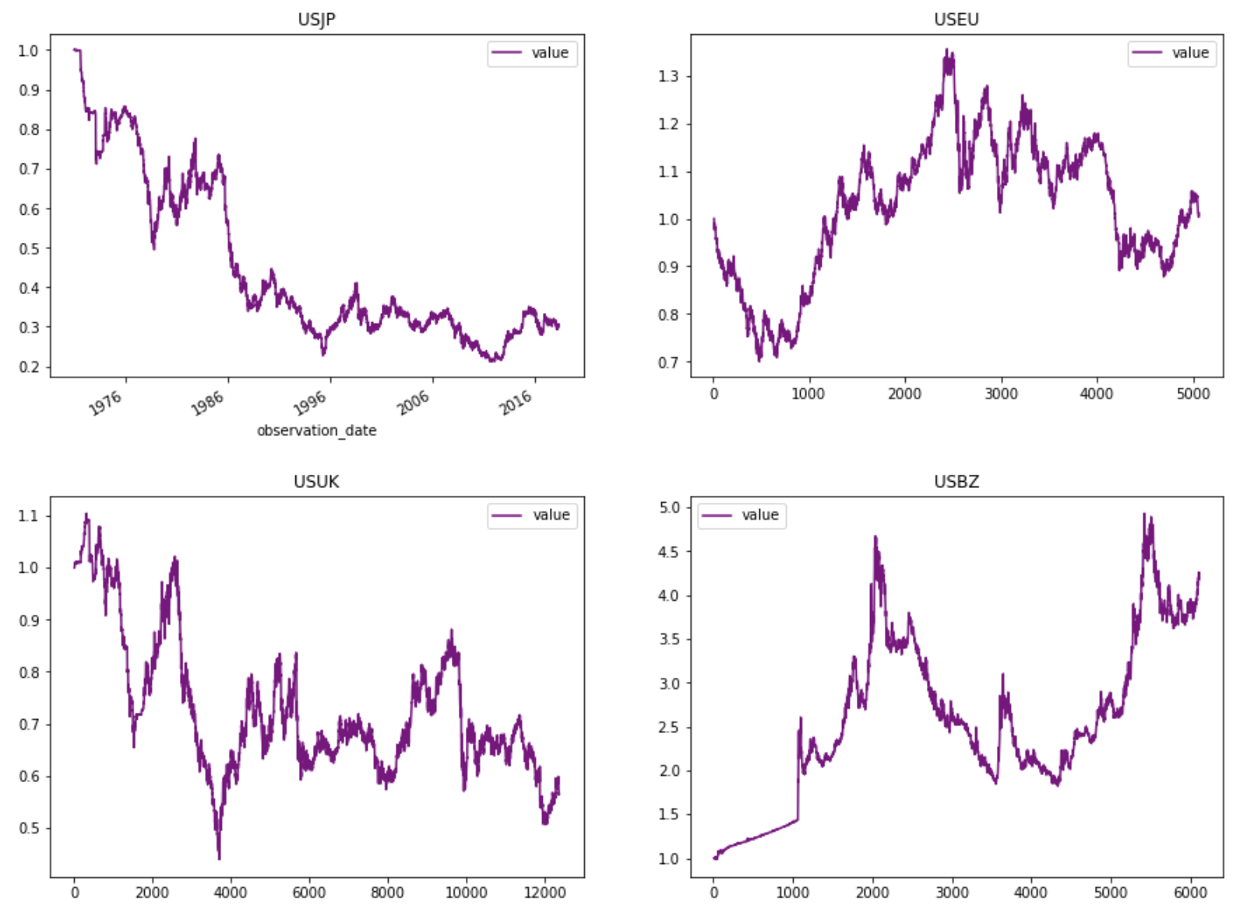
Cumulative Daily Return

Slide 31
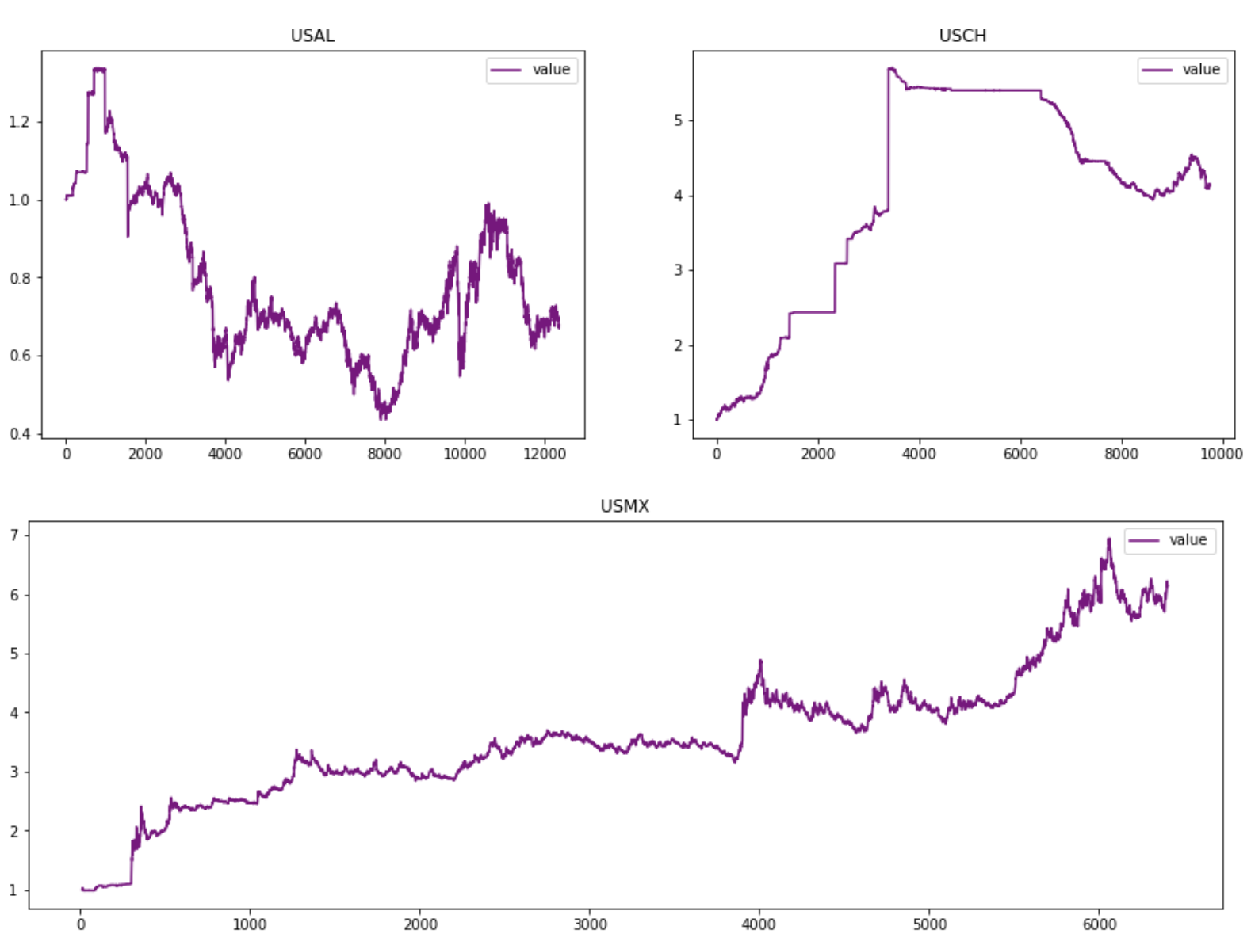

Slide 32
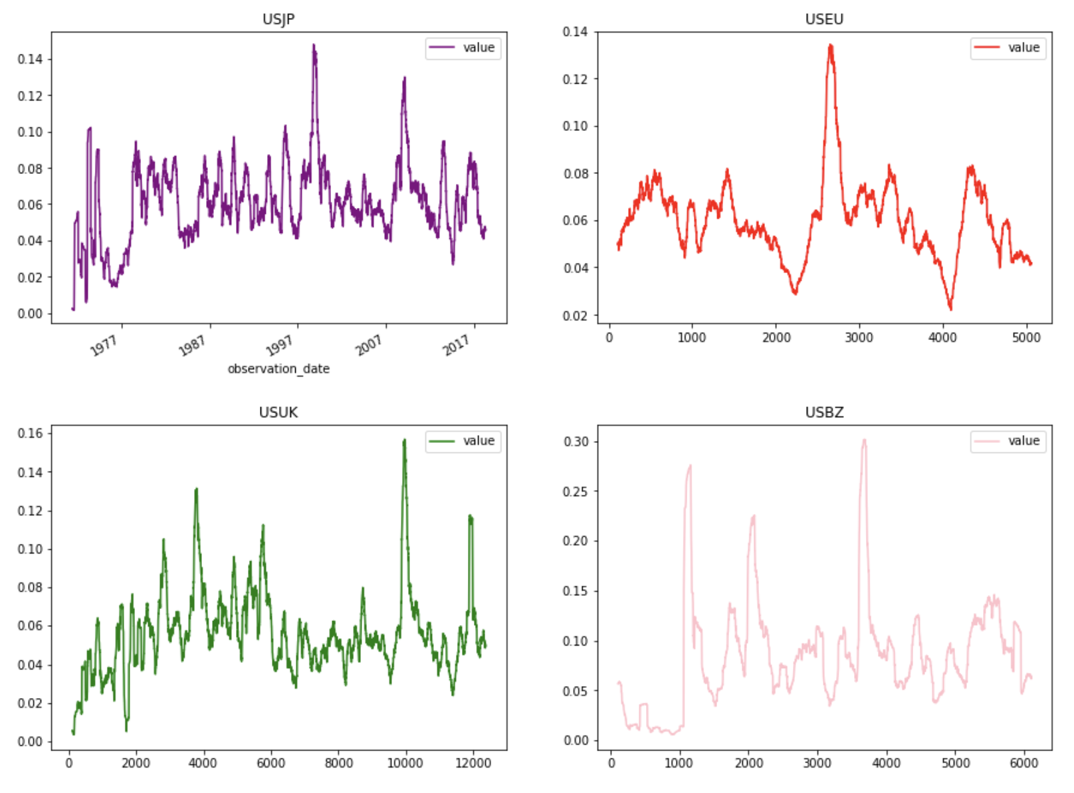
Volatility

Slide 33
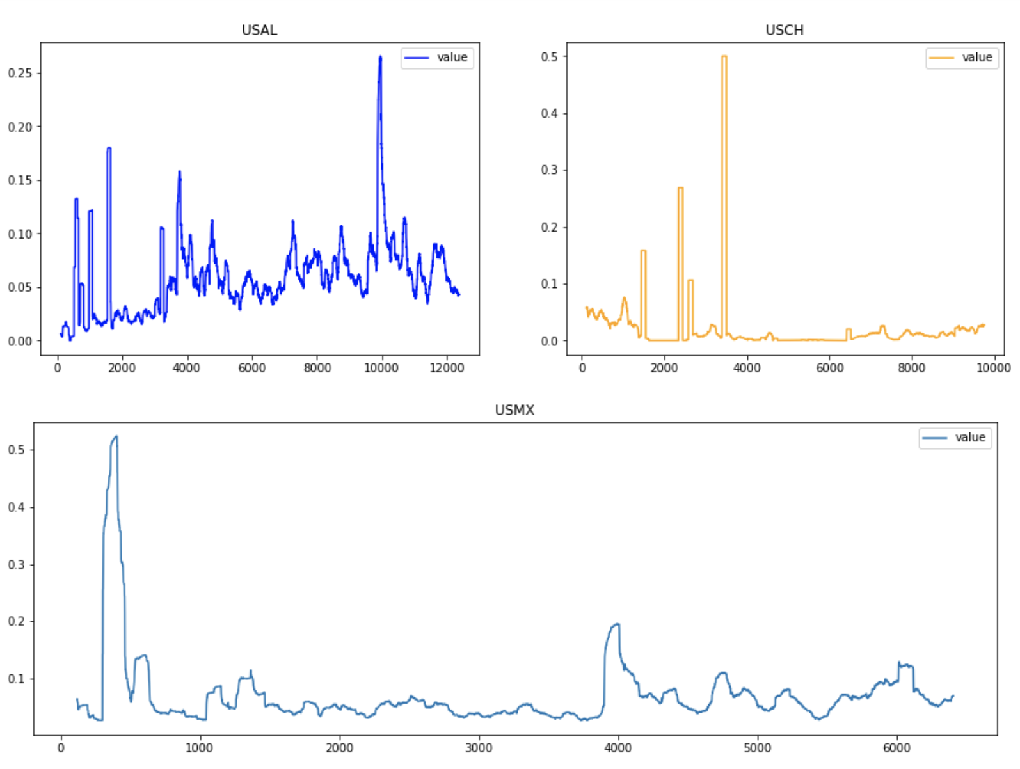
Volatility

Slide 34
Bollinger Bands
Bollinger Bands are non-static indicators
They change their shape based on recent price action and accurately measure momentum and volatility.
To analyze trend strength:
1. During strong trends, price stays close to the outer band
2. If price pulls away from the outer band as the trend continues, it shows fading momentum
3. Repeated pushes into the outer bands that don’t actually reach the band show a lack of power
4. A break of the moving average is often the signal that a trend is ending

Slide 35
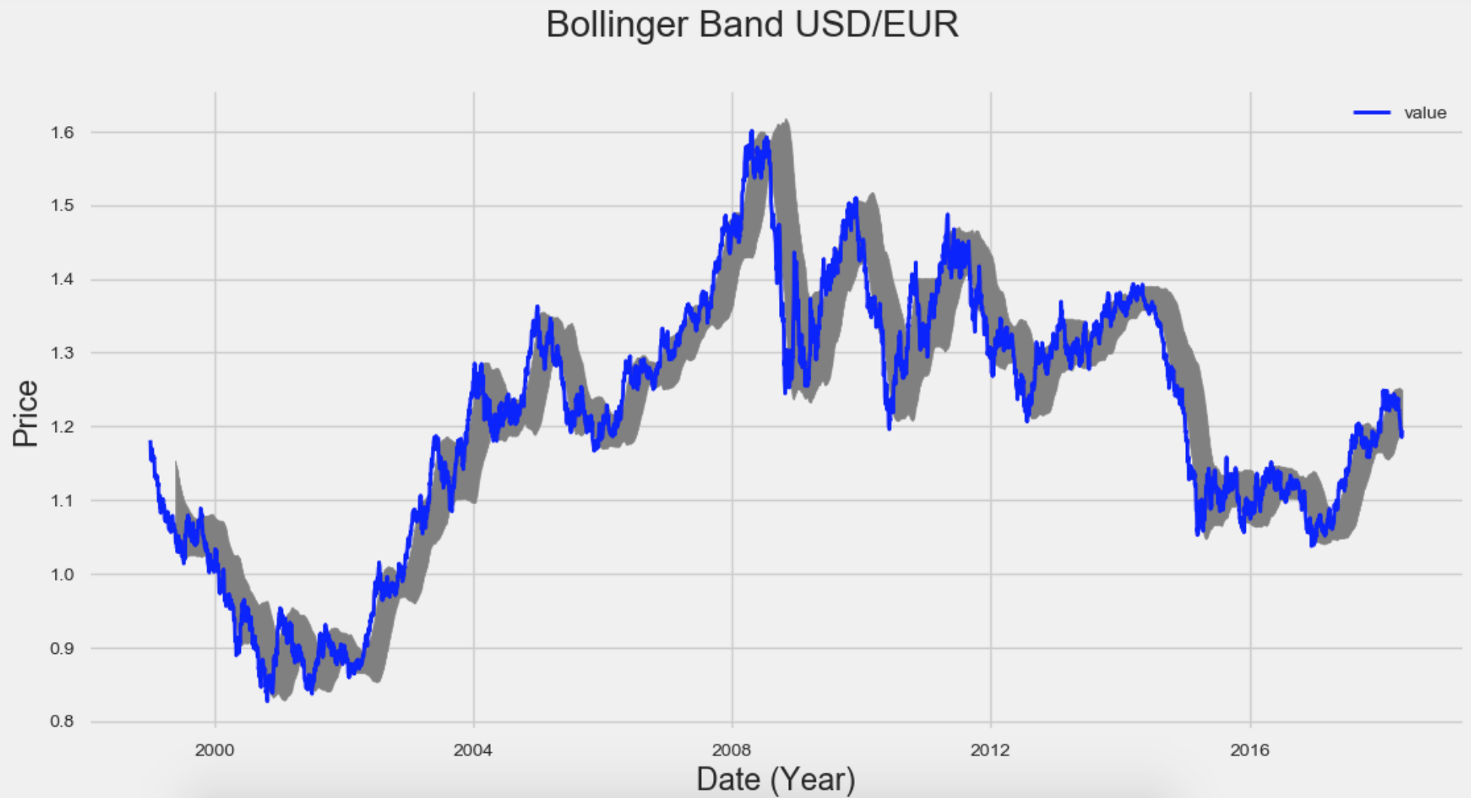
Bollinger Bands

Slide 36
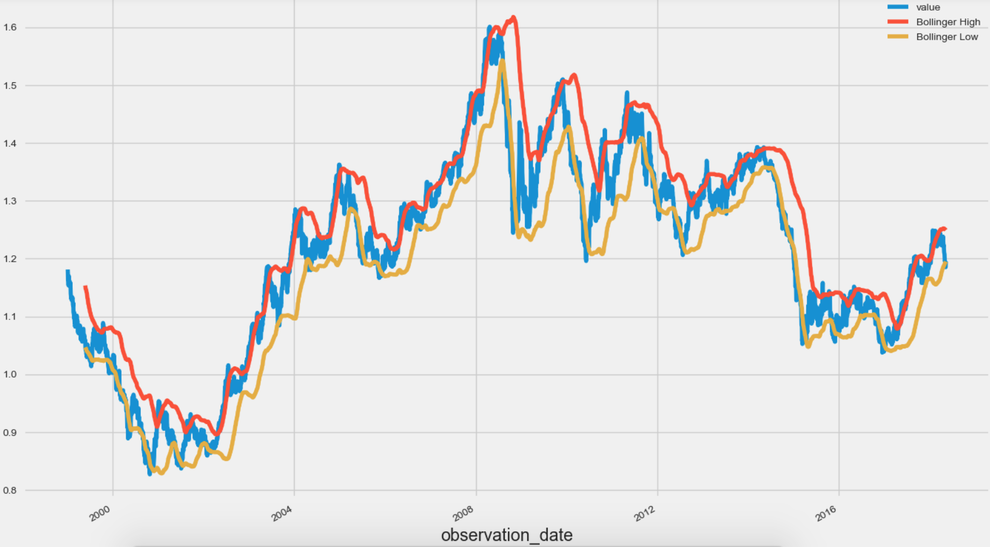
Bollinger Bands - USD-EUR

Slide 37
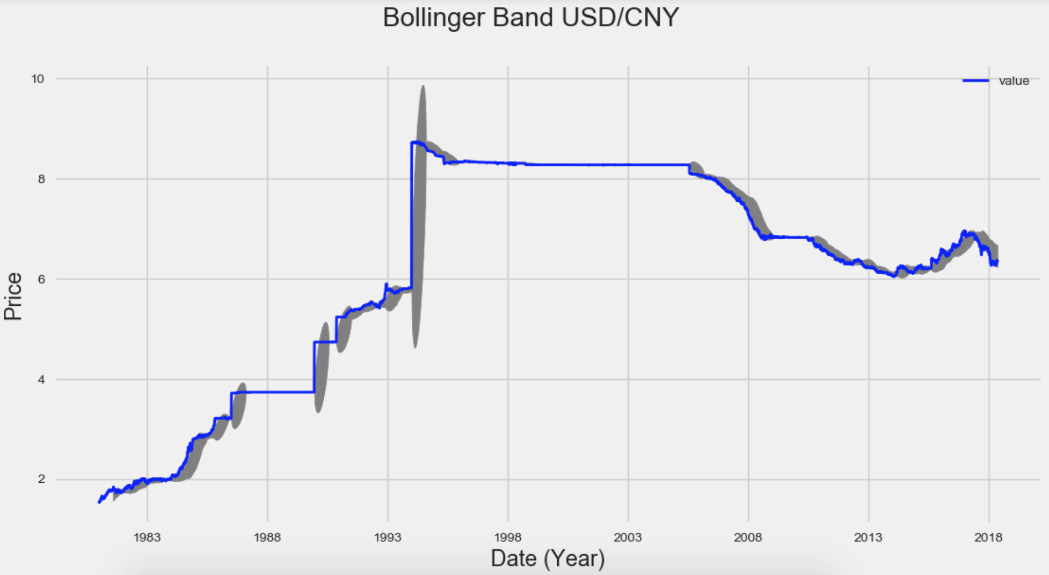
Bollinger Bands
Approximately 90% of price action occurs between the two bands.
Any breakout above or below the bands is a major event.
The mistake most people make is believing that that price hitting or exceeding one of the bands is a signal to buy or sell.

Slide 38
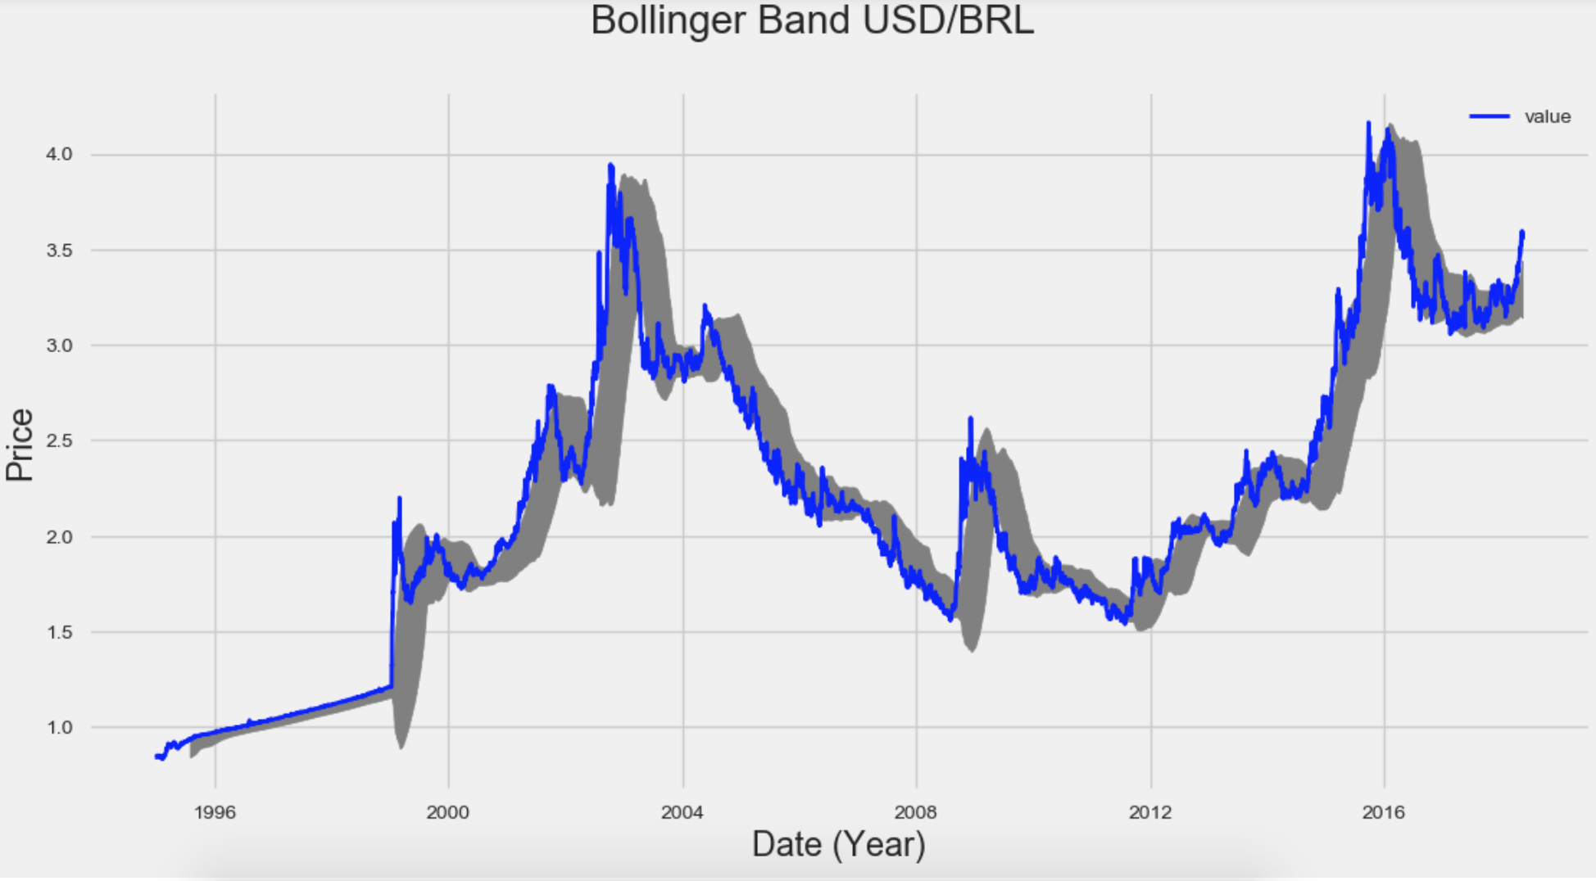
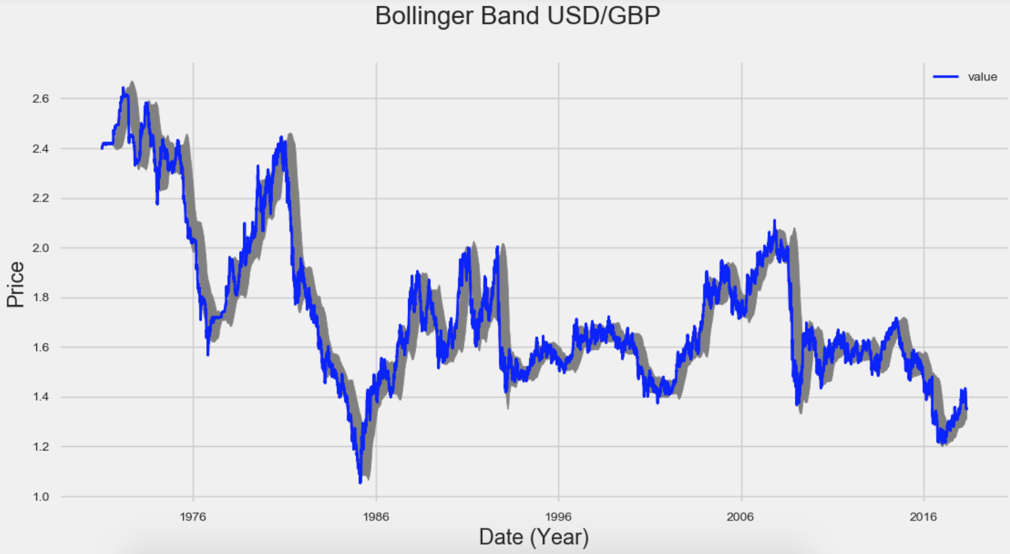
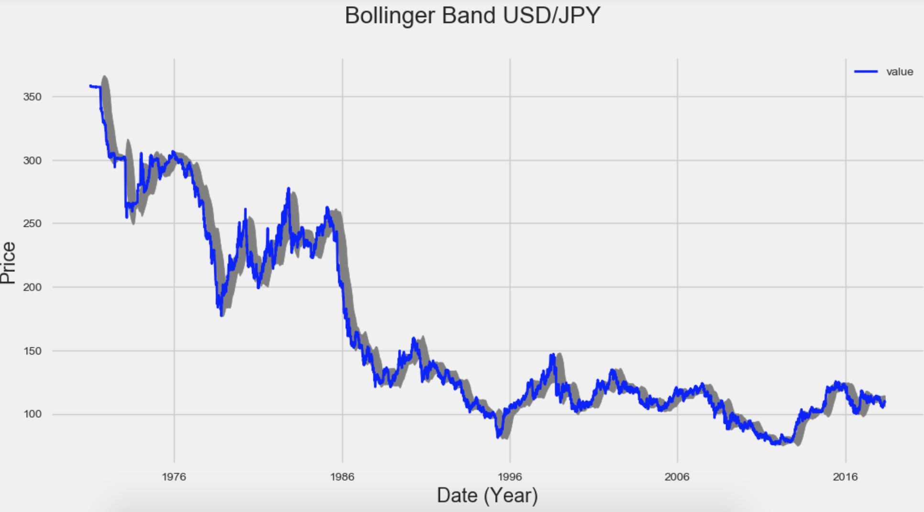
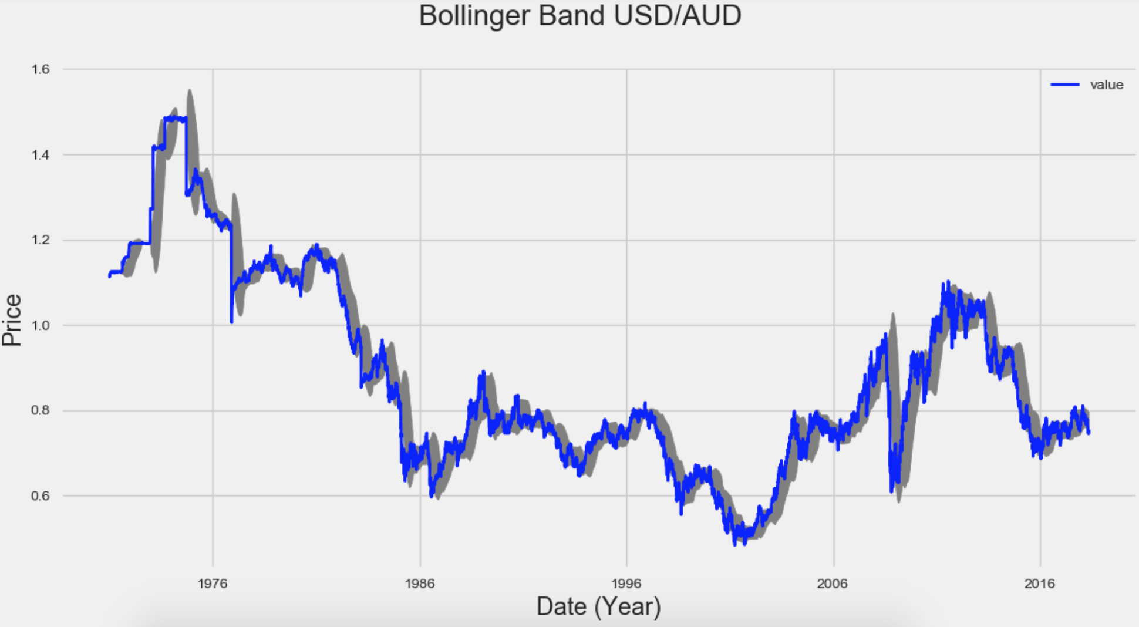
Bollinger Bands

Slide 39
Kalman Filter
It is a recursive solution to estimate and predict discrete data
It is a predictor, corrector type estimator that minimises the estimated error covariance with each new measurement
Ideally used for systems that are continuously changing as they are light on memory
The underlying model is similar to a hidden Markov model except that the state space of the latent variables is continuous and all latent and observed variables have Gaussian distributions

Slide 40
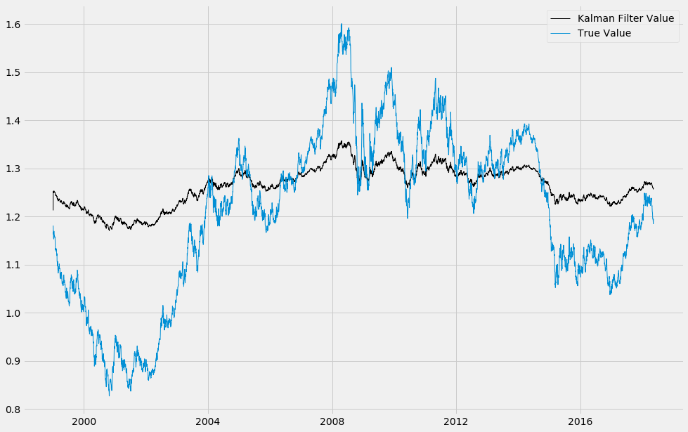

Slide 41
Principal Component Analysis
Principal component analysis (PCA) is a statistical procedure that uses an orthogonal transformation to convert a set of observations of possibly correlated variables into a set of values of linearly uncorrelated variables called principal components.
PCA is mostly used as a tool in exploratory data analysis and for making predictive models
PCA can be done by eigenvalue decomposition of a data covariance (or correlation) matrix or singular value decomposition of a data matrix, usually after mean centering and normalizing or using Z-scores) the data matrix for each attribute.
PCA is the simplest of the true eigenvector-based multivariate analyses.

Slide 42
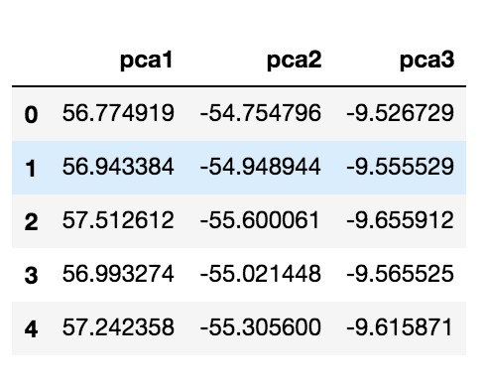

Slide 43
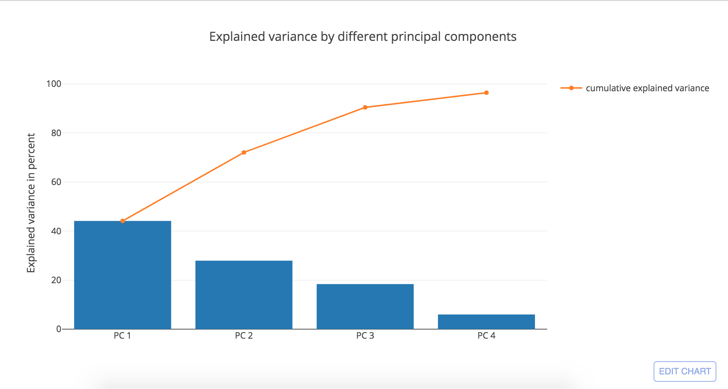

Slide 44
Ordinary Least Squares Regressions
For the FOREX market we calculate the PCA to obtain 3 principal components.
Principal Component Analysis is done using the Covariance of the different currency sets.
Eigenvectors and Eigenvalues are calculated from the covariance matrix.
The eigenvectors and eigenvalues are calculated and are sorted in decreasing order to find the most important Principal Component moving towards the least important.
Principal Components are used in the calculation of OLS Regression, where the X1, X2 and X3 is the Principal Components.
𝛽̂=(𝑋′ 𝑋)-1 𝑋′𝑌
Regressed Values can be verified using the T-Test and F-Test.

Slide 45
